Slide 1
Big Data - Lecture 4
Aggregate Data Models/Stores

Slide 2
Relational Model
The relational model takes the information that we want to store and divides it into tuples (rows). A tuple is a limited data structure: It captures a set of values, so you cannot nest one tuple within another to get nested records, nor can you put a list of values or tuples within another. This simplicity underpins the relational model —it allows us to think of all operations as operating on and returning tuples.

Slide 3
Aggregates
Aggregate orientation takes a different approach. It recognizes that often, you want to operate on data in units that have a more complex structure than a set of tuples.
It can be handy to think in terms of a complex record that allows lists and other record structures to be nested inside it.
Key-value, document, and column-family databases all make use of this more complex record.
Aggregates are also often easier for application programmers to work with, since they often manipulate data through aggregate structures.

Slide 4
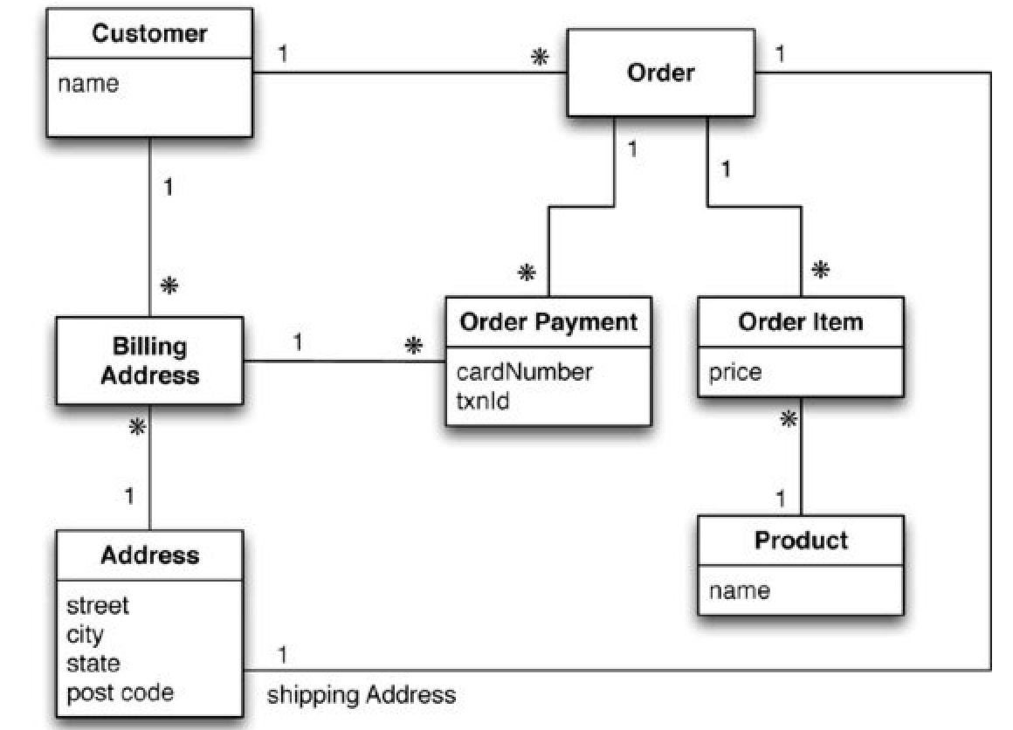
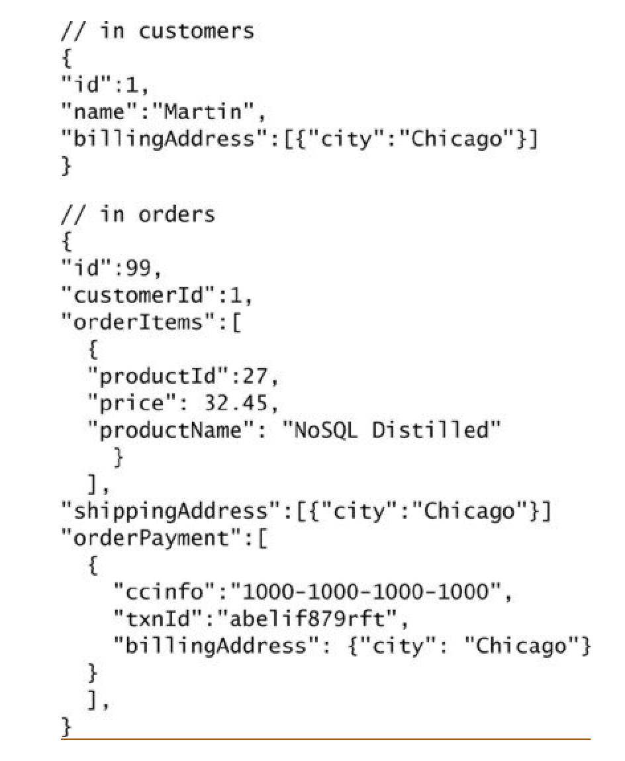
Relational vs. Aggregate

Slide 5
Differences
In this model, we have two main aggregates: customer and order.
The customer contains a list of billing addresses; the order contains a list of order items, a shipping address, and payments. The payment itself contains a billing address for that payment.
A single logical address record appears three times in the example data, but instead of using IDs it’s treated as a value and copied each time.
In a relational database, we would ensure that the address rows aren’t updated for this case, making a new row instead. With aggregates, we can copy the whole address structure into the aggregate as we need to.
The link between the customer and the order isn’t within either aggregate— it’s a relationship between aggregates.

Slide 6
How will you access data?
The important thing to notice here isn’t the particular way we’ve drawn the aggregate boundary so much as the fact that you have to think about accessing that data— and make that part of your thinking when developing the application data model. Indeed we could draw our aggregate boundaries differently, putting all the orders for a customer into the customer aggregate.
Like most things in modeling , there’s no universal answer for how to draw your aggregate boundaries. It depends entirely on how you tend to manipulate your data.
If you tend to access a customer together with all of that customer’s orders at once, then you would prefer a single aggregate. However, if you tend to focus on accessing a single order at a time, then you should prefer having separate aggregates for each order.
Naturally, this is very context-specific; some applications will prefer one or the other, even within a single system, which is exactly why many people prefer aggregate ignorance.

Slide 7
Consequences
It’s often difficult to draw aggregate boundaries well, particularly if the same data is used in many different contexts. An order makes a good aggregate when a customer is making and reviewing orders, and when the retailer is processing orders. However, if a retailer wants to analyze its product sales over the last few months, then an order aggregate becomes a trouble.
An aggregate-ignorant model allows you to easily look at the data in different ways, so it is a better choice when you don’t have a primary structure for manipulating your data.
The clinching reason for aggregate orientation is that it helps greatly with running on a cluster, which is the killer argument for the rise of NoSQL. If we’re running on a cluster, we need to minimize how many nodes we need to query when we are gathering data.
By explicitly including aggregates, we give the database important information about which bits of data will be manipulated together, and thus should live on the same node.
This article by Sarah Mei give a great example of how changing customer requirements can really mess with your data store design -> Why you should never use MongoDB - Sarah Mei

Slide 8
Transactions
Aggregates have an important consequence for transactions. Relational databases allow you to manipulate any combination of rows from any tables in a single transaction (ACID).
Many rows spanning many tables are updated as a single operation . This operation either succeeds or fails in its entirety, and concurrent operations are isolated from each other so they cannot see a partial update.
In general, it’s true that aggregate-oriented databases don’t have ACID transactions that span multiple aggregates . Instead , they support atomic manipulation of a single aggregate at a time. This means that if we need to manipulate multiple aggregates in an atomic way, we have to manage that ourselves in the application code.

Slide 9
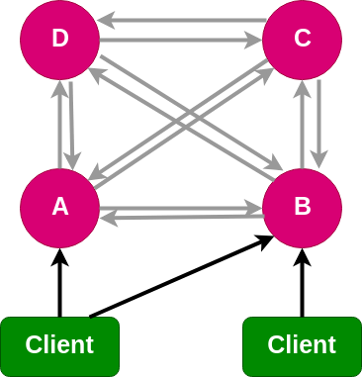
Clustering
Fault Tolerant
Self Healing
Failed nodes can be replaced with no downtime
Data Replication
For a cluster to be fault tolerant the data must be replicated across multiple nodes often configurable with a replication factor ex. RF=2 meaning there are two copies of each value
High Availability
By having multiple nodes with replicated data available to serve a request clusters can provide a very high level of availability aka. uptime.
Eventual Consistency
Updates to any data will eventually propagated to all replicated items
Some systems allow you to configure the number of nodes that have acknowledged the update prior to completing the transactions. For example requiring at least ⅖ nodes to acknowledge the update.

Slide 10
Key-Value Models
In a key-value database, the aggregate is opaque to the database— just some big blob of mostly meaningless bits.
The advantage of opacity is that we can store whatever we like in the aggregate. The database may impose some general size limit, but other than that we have complete freedom.
With a key-value store, we can only access an aggregate by lookup based on its key.
Databases classified as key-value databases may allow you structures for data beyond just an opaque aggregate, but the ability to query the aggregate is often limited.

Slide 11
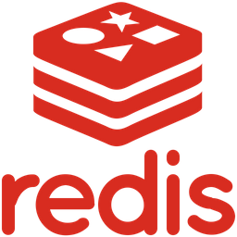
Example - Redis
Redis is a in-memory data structure store
Supports common data structures such as strings, hashes, lists, sets, and sorted sets
You can think of Redis as a giant dictionary
Highly performant reads
Natively Redis only offers primary key access meaning queries are typically limited to simple sets/gets with the primary key. Redis doesn’t make it easy to query the data structures stored as values.
It is possible to create secondary indexes in redis with sorted sets and range queries. It is considered an advanced topic and should be used with caution.
// Example using redis-py
import redis
r = redis.Redis(host='localhost', port=6379, db=0)
// Recommended key structure
// object-type:id
r.set('order:8372',
“lineitems”: [
{
“description”: “The Pragmatic Programmer”,
“price”: 34.99
}
])
r.get('order:8372')
Notes:
Schema can be difficult to maintain
-

Slide 12
Redis Persistence
Redis Database File (RDB) Persistence
Point in time snapshot of your dataset at a specified interval
Commonly used for data backups and is very useful in disaster recovery
NOT good if you need to minimize the chance of data loss
Append Only File (AOF) Persistence
Redis can be configured to create a append only change-log that can be used to reconstruct the data store in the event of a failure
AOF can be slower than RDB as it has to frequently sync changes with the change-log which can become very large if there are a significant amount of writes.
Persistence is entirely optional with Redis
Many people use Redis as a feature rich caching system and treat it as an ephemeral data source that can fall down and be reconstructed from a persistent data store ex. Postgres.

Slide 13
Redis Use Cases
Job Queues/Message Broker
Redis is really good at storing temporary state like a queue of jobs that are constantly being worked
Very popular with queueing libraries ex. Celery, RQ, etc.
Primarily used in job queues that don’t require/rely on persistence
Game Leaderboards
Can use a sorted-set in redis to keep track of real-time leaderboards which provides uniqueness of elements while maintaining the list sorted by users’ scores
Publication/Subscriber
Redis has built in support for publishing channels and notifying subscribers of events. It can be used to handle high rates of real-time data. For example, Redis is used in Realie a real-time collaborative code editor to help keep the two editors in sync.

Slide 14
Redis Tradeoffs
Pros
Really easy to use
Highly scalable
Fast!
Supports commonly used data structures and nesting
The Redis community is very active and there are a lot of add-ons/features to Redis that support things like full-text search, pub/sub, geospatial data, keys with limited time-to-live, etc.
Cons
Primary key access
Querying data structures is limited
Secondary indexes is really only recommended for advance use
Does not support the rollback of a transactions so making updates of a large data set can be risky
Since Redis is an in-memory data store persistence must be managed and is not recommended if your system is not tolerant to data loss
The data structures stored in Redis are incredibly flexible, but that can also make them difficult to deal in code as the data structure may change over time ex. Adding new fields.

Slide 15
Document Models
A document database is able to see a structure in the aggregate.
A document database imposes limits on what we can place in it, defining allowable structures and types.
With a document database, we can submit queries to the database based on the fields in the aggregate, we can retrieve part of the aggregate rather than the whole thing, and database can create indexes based on the contents of the aggregate.
People often put an ID field in a document database to do a key-value style lookup.

Slide 16

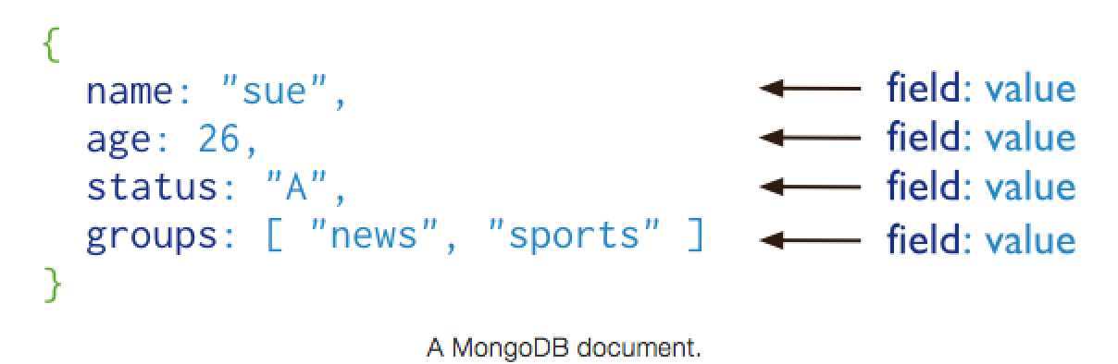
Example - MongoDB
MongoDB stores data in the form of documents, which are JSON-like field and value pairs.
Documents are analogous to structures in programming languages that associate keys with values, where keys may hold other pairs of keys and values (e.g. dictionaries, hashes, maps, and associative arrays).
Normally, MongoDB documents are BSON documents, which is a binary representation of JSON with additional type information.

Slide 17
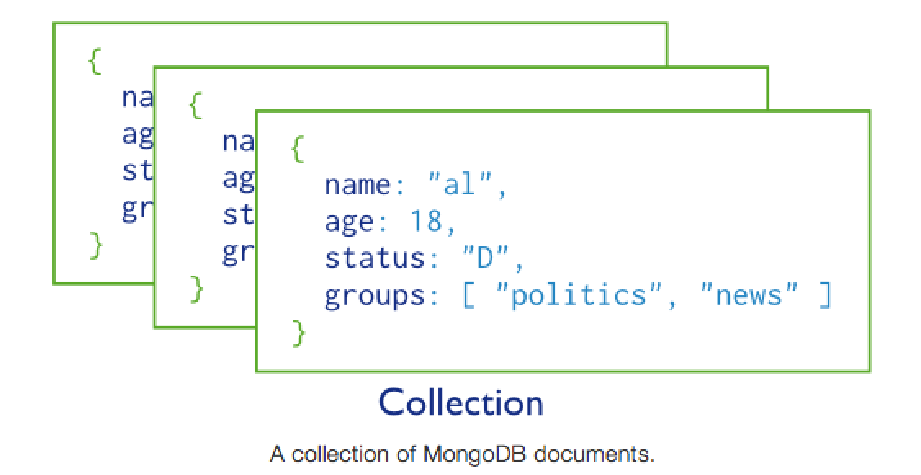
Collections
MongoDB stores all documents in collections. A collection is a group of related documents that have a set of shared common indexes. Collections are analogous to a table in relational databases.

Slide 18
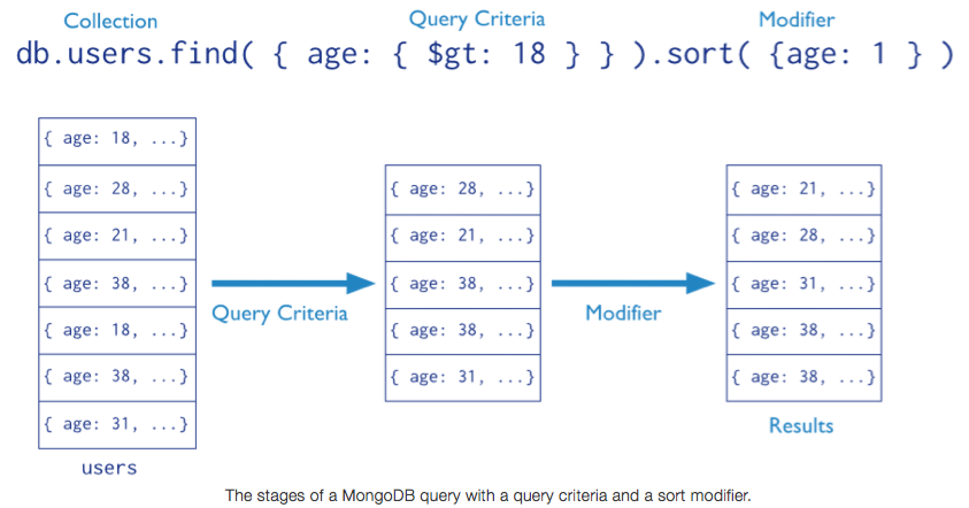
Query
In MongoDB a query targets a specific collection of documents. Queries specify criteria, or conditions, that identify the documents that MongoDB returns to the clients.
A query may include a projection that specifies the fields from the matching documents to return. You can optionally modify queries to impose limits, skips, and sort orders.

Slide 19
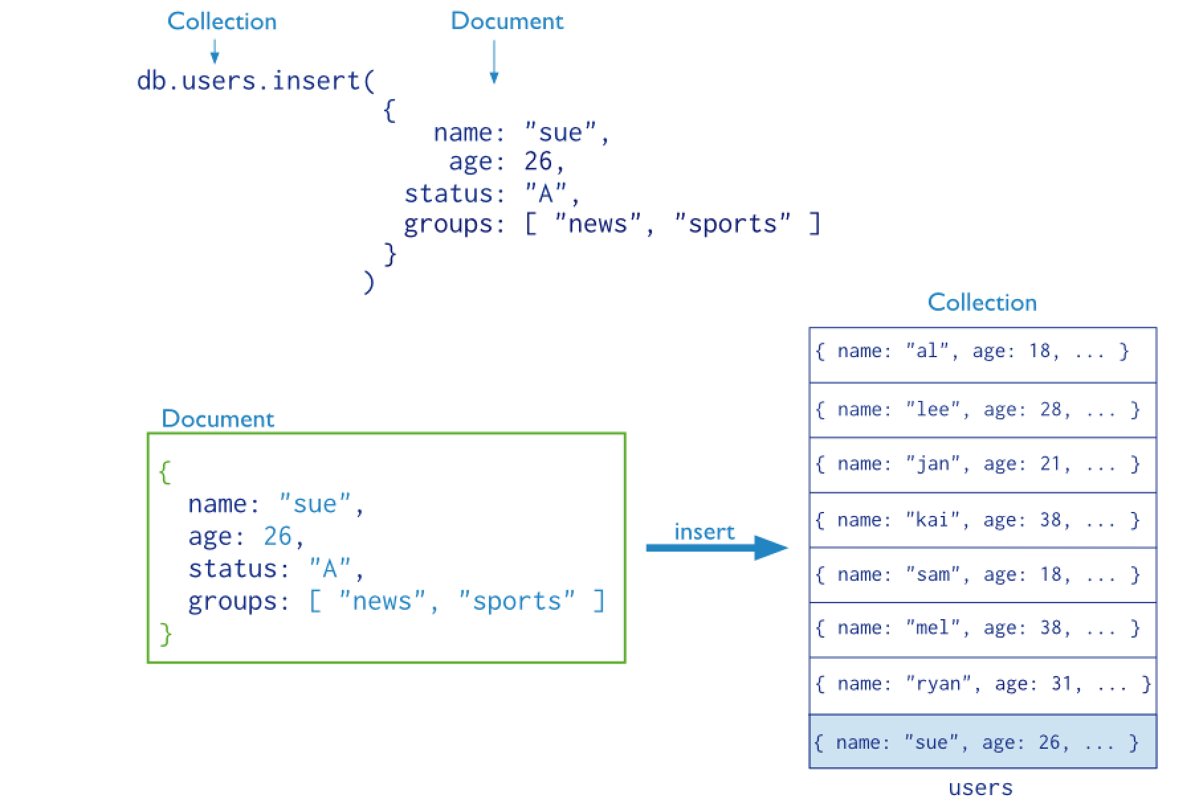
Modification
Data modification refers to operations that create, update, or delete data. In MongoDB, these operations modify the data of a single collection. For the update and delete operations, you can specify the criteria to select the documents to update or remove.

Slide 20
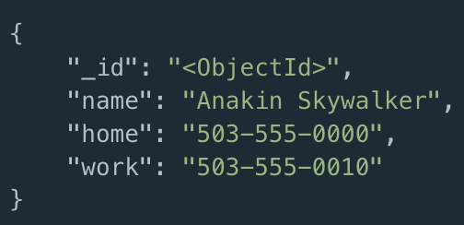
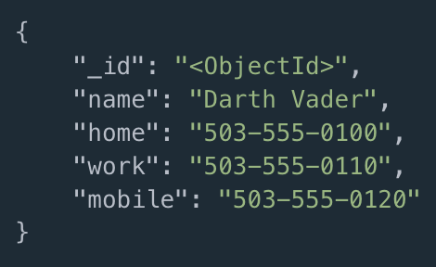
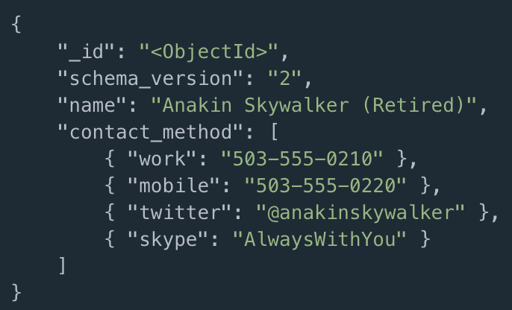
Schema Versioning Pattern
By default MongoDB does not require documents in a collection to have the same schema.
The schema versioning patterns simply asks you to add a schema_version number to your document that can be incremented as the document structure changes over time. By looking at the schema_version in your code you can anticipate the shape of the document and add in support for legacy document versions as well as identify any deprecated versions.
Example of a schema_version
*This pattern can be used in most aggregate stores ex. Redis

Slide 21
Other Features
Indexes
To enhance the performance of common queries and updates, MongoDB has full support for secondary indexes. These indexes allow applications to store a view of a portion of the collection in an efficient data structure. Most indexes store an ordered representation of all values of a field or a group of fields. Indexes may also enforce uniqueness, store objects in a geospatial representation, and facilitate text search.
Read Preference
For replica sets and sharded clusters with replica set components, applications specify read preferences. A read preference determines how the client direct read operations to the set.
Write Concern
Applications can also control the behavior of write operations using write concern. Particularly useful for deployments with replica sets, the write concern semantics allow clients to specify the assurance that MongoDB provides when reporting on the success of a write operation.
Aggregation
In addition to the basic queries, MongoDB provides several data aggregation features. For example, MongoDB can return counts of the number of documents that match a query, or return the number of distinct values for a field, or process a collection of documents using a versatile stage-based data processing pipeline or map-reduce operations.
More at: http://www.mongodb.com/

Slide 22
Column Stores
Databases with a bigtable-style data model are often referred to as column stores, but that name has been around for a while to describe a different animal.
Pre-NoSQL column stores, such as C-Store [C-Store] , were happy with SQL and the relational model. The thing that made them different was the way in which they physically stored data.
Most databases have a row as a unit of storage which, in particular, helps write performance. However, there are many scenarios where writes are rare, but you often need to read a few columns of many rows at once. In this situation, it’s better to store groups of columns for all rows as the basic storage unit— which is why these databases are called column stores.
Bigtable and its offspring follow this notion of storing groups of columns (column families) together, but part company with C-Store and friends by abandoning the relational model and SQL.
We refer to this class of databases as column-family databases.

Slide 23
What is a column family?
Perhaps the best way to think of the column-family model is as a two-level aggregate structure . As with key-value stores, the first key is often described as a row identifier, picking up the aggregate of interest.
The difference with column-family structures is that this row aggregate is itself formed of a map of more detailed values. These second-level values are referred to as columns.
As well as accessing the row as a whole, operations also allow picking out a particular column, so to get a particular customer’s name from the example you could do something like get(' 1234', 'name').
Column-family databases organize their columns into column families. Each column has to be part of a single column family, and the column acts as unit for access, with the assumption that data for a particular column family will be usually accessed together.

Slide 24
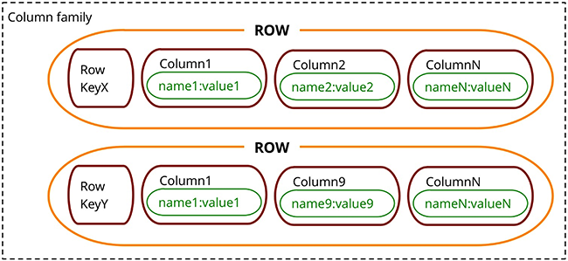
Column Family Data Model

Slide 25
Column-Family Models
One of the early and influential NoSQL databases was Google’s BigTable [Chang etc.] . Its name conjured up a tabular structure which it realized with sparse columns and no schema.
It doesn’t help to think of this structure as a table; rather, it is a two-level map.
It has been a model that influenced later databases such as HBase and Cassandra.
The best way to think of the column-family model is as a two-level aggregate structure . As with key-value stores, the first key is often described as a row identifier, picking up the aggregate of interest.
The difference with column-family structures is that this row aggregate is itself formed of a map of more detailed values. These second-level values are referred to as columns.

Slide 26
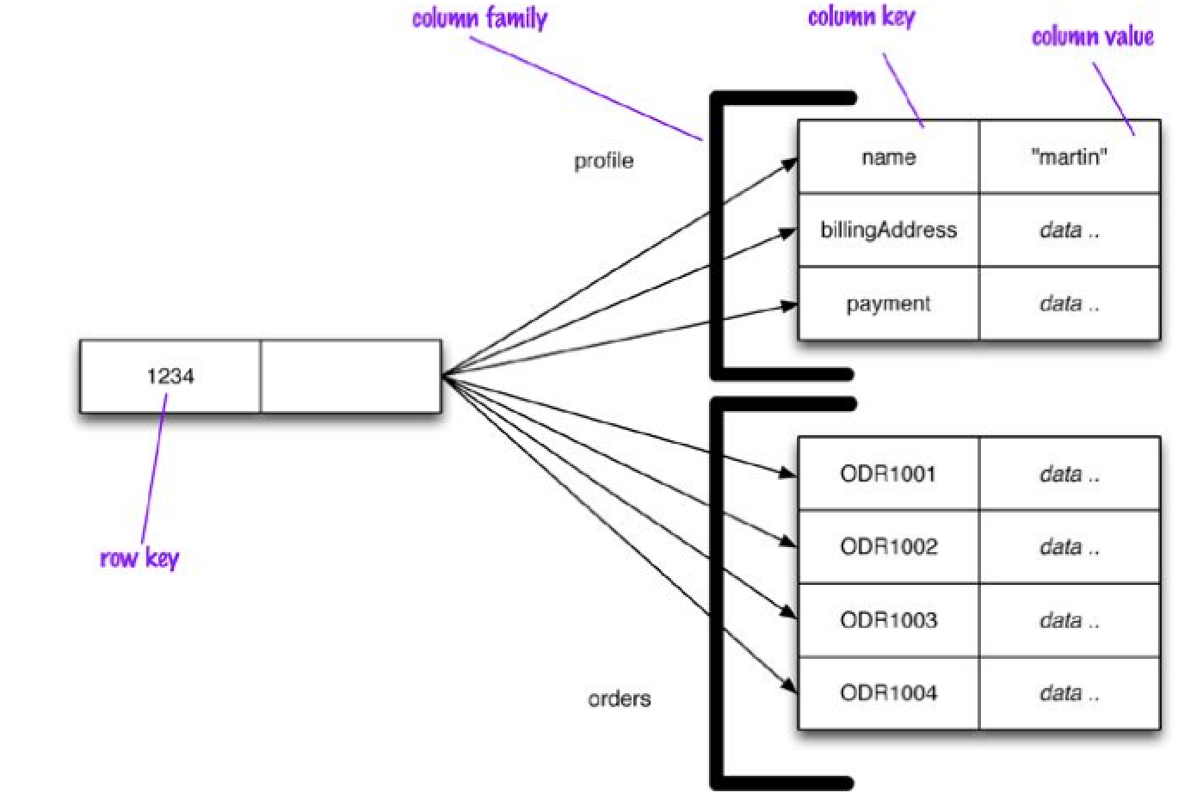
Example

Slide 27
Row vs. Column view
This also gives you a couple of ways to think about how the data is structured:
• Row-oriented: Each row is an aggregate (for example, customer with the ID of 1234) with column families representing useful chunks of data (profile, order history) within that aggregate.
• Column-oriented: Each column family defines a record type (e.g., customer profiles) with rows for each of the records. You then think of a row as the join of records in all column families.

Slide 28
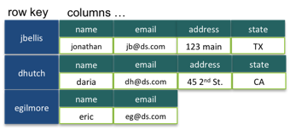
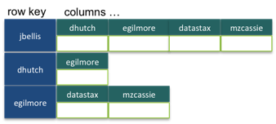
Wide vs. Skinny rows
Cassandra uses the terms “wide” and “skinny.”
Skinny rows have few columns with the same columns used across the many different rows. In this case, the column family defines a record type, each row is a record, and each column is a field.
A wide row has many columns (perhaps thousands), with rows having very different columns. A wide column family models a list, with each column being one element in that list.

Slide 29
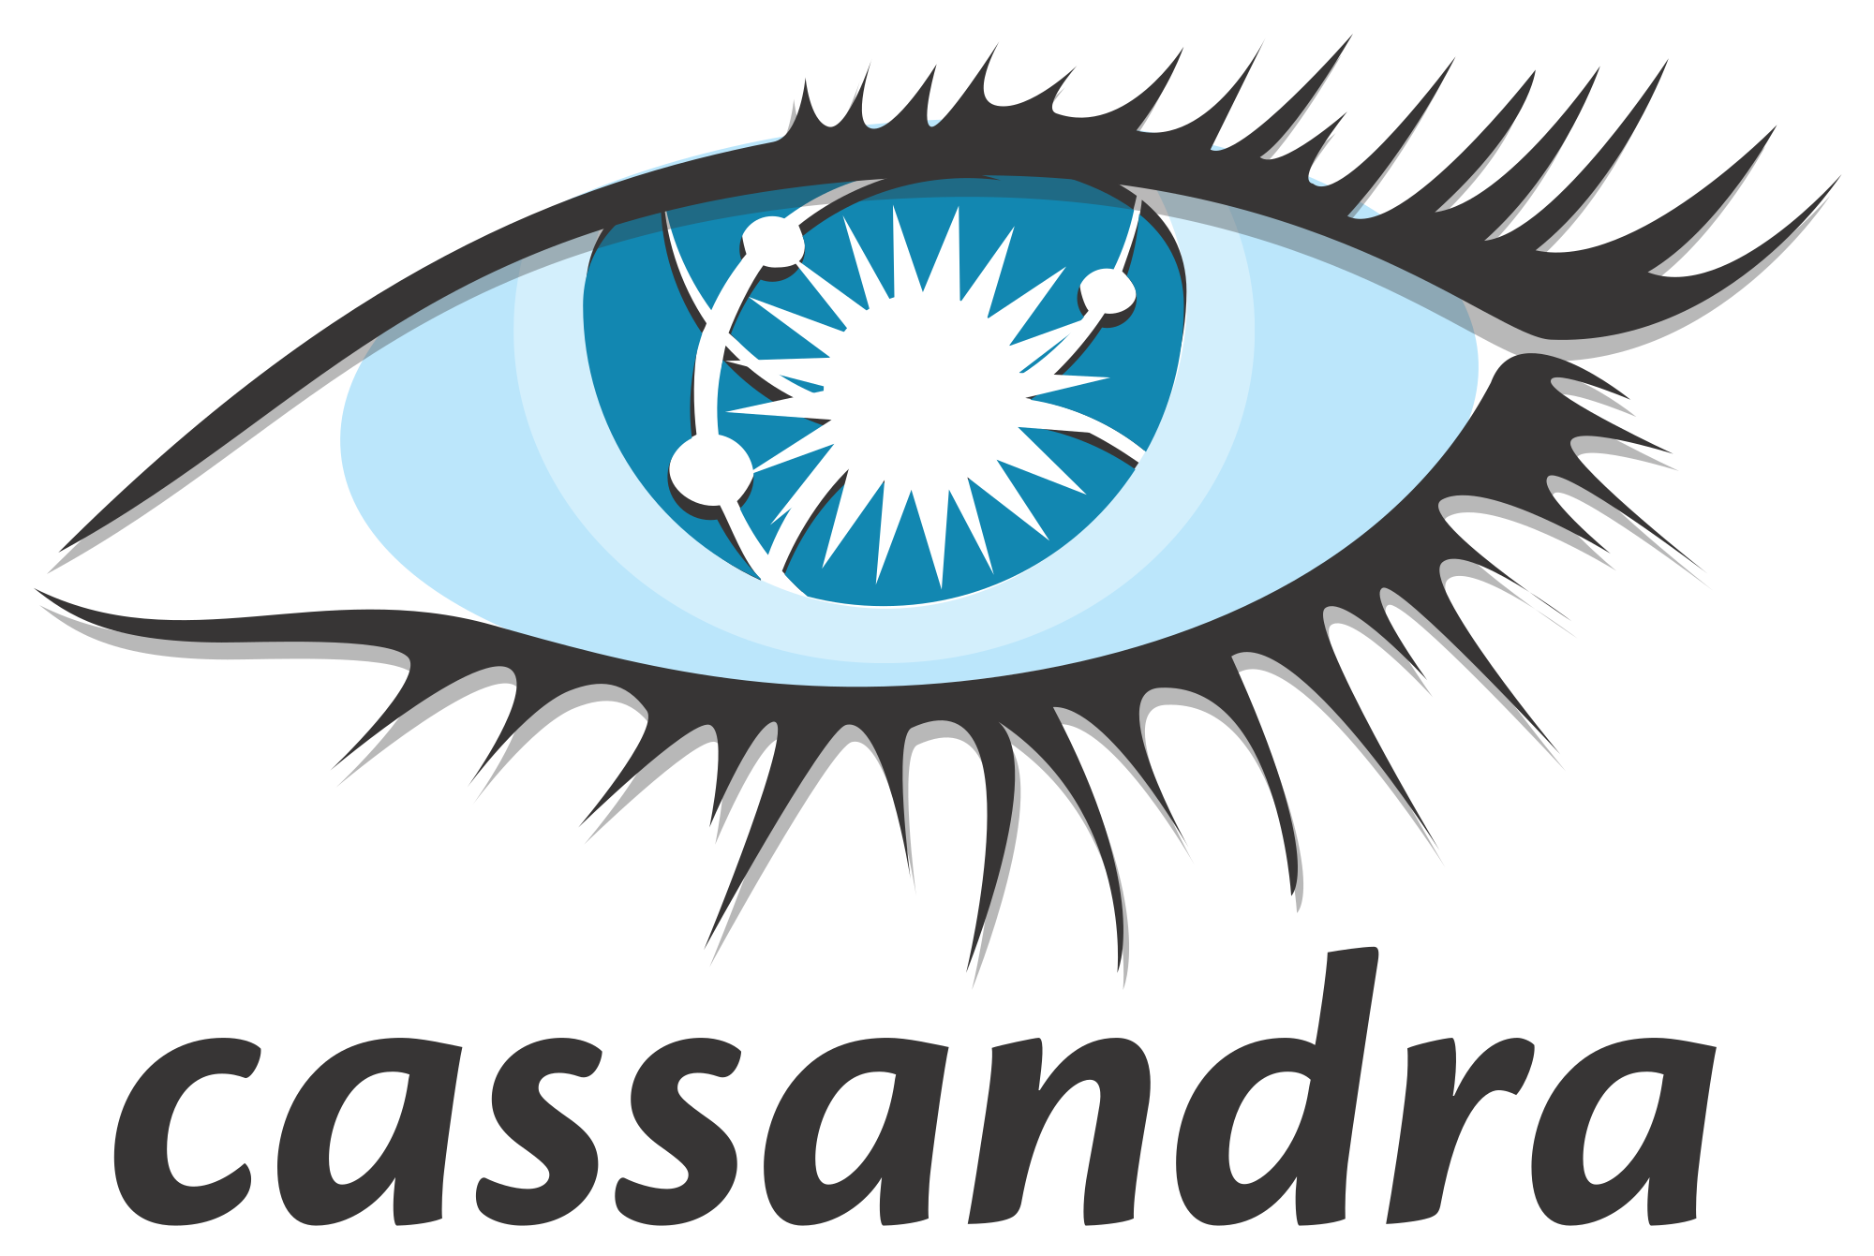
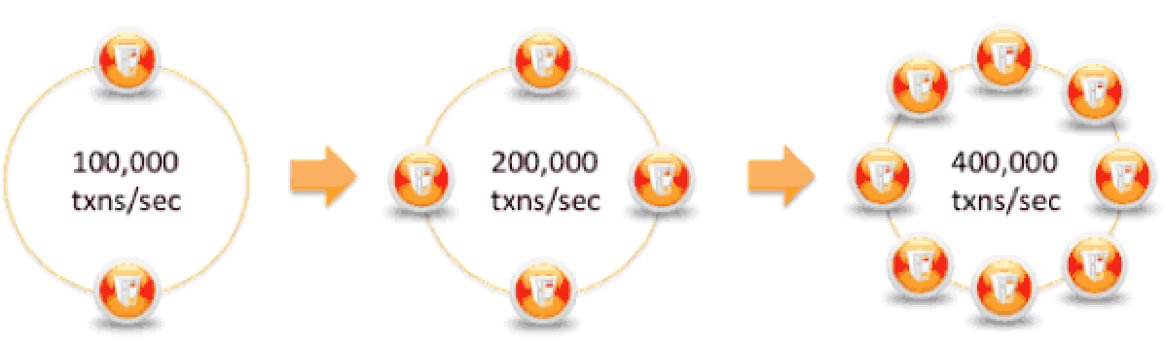
Example - Cassandra
Apache Cassandra™ is a massively scalable open source NoSQL database. Cassandra is perfect for managing large amounts of structured, semi-structured, and unstructured data across multiple data centers and the cloud. Cassandra delivers continuous availability, linear scalability, and operational simplicity across many commodity servers with no single point of failure, along with a powerful dynamic data model designed for maximum flexibility and fast response times.
Cassandra supplies linear scalability, meaning that capacity may be easily added simply by adding new nodes online. For example, if 2 nodes can handle 100,000 transactions per second, 4 nodes will support 200,000 transactions/sec and 8 nodes will tackle 400,000 transactions/sec:

Slide 30
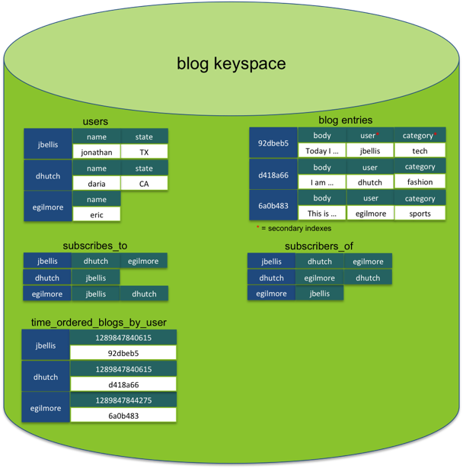
C* Data Model example

Slide 31
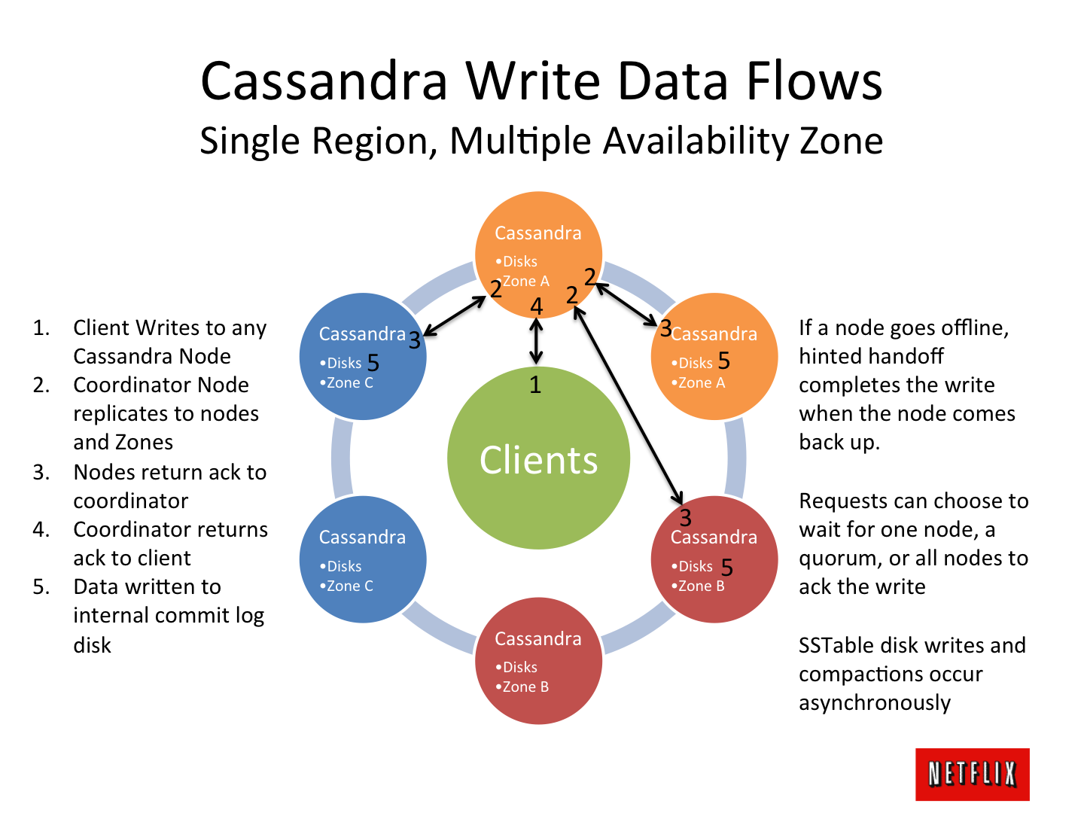
Source
Benchmarking Cassandra Scalability on AWS — Over a million writes per second
Netflix

Slide 32

Jonathan Ellis from C*
https://www.youtube.com/watch?v=JX9A85jKPag

